Slide 1
In The Name Of God

Slide 2
Ion Exchange Chromatography
Principles and Methods

Slide 3
The theory of ion exchange
Separation in ion exchange chromatography depends upon the reversible adsorption
of charged solute molecules to immobilized ion exchange groups of opposite charge.
Most ion exchange experiments are performed in five main stages. These
steps are illustrated schematically below.

Slide 4
The theory of ion exchange
The first stage is equilibration in which the ion exchanger is brought to a starting
state, in terms of pH and ionic strength, which allows the binding of the desired
solute molecules.

Slide 5
The theory of ion exchange
The second stage is sample application and adsorption, in which solute molecules
carrying the appropriate charge displace counter-ions and bind reversibly to the
gel.

Slide 6
The theory of ion exchange
In the third stage, substances are removed from the column by changing to elution
conditions unfavourable for ionic bonding of the solute molecules.

Slide 7
The theory of ion exchange
The fourth and fifth stages are the removal from the column of substances not eluted
under the previous experimental conditions and re-equilibration at the starting
conditions for the next purification.

Slide 8
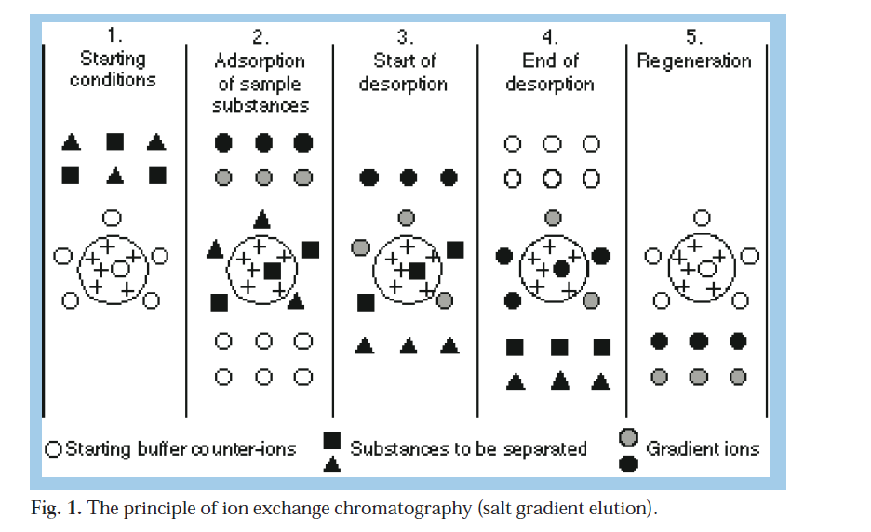

Slide 9
The matrix
An ion exchanger consists of an insoluble matrix to which charged groups have
been covalently bound
It is possible to have both positively and negatively charged exchangers.

Slide 10
Charged groups
The presence of charged groups is a fundamental property of an ion exchanger.
The type of group determines the type and strength of the ion exchanger; their
total number and availability determines the capacity.

Slide 11
Charged groups
Anion exchangers
Diethylaminoethyl (DEAE)
Quaternary aminoethyl (QAE)
Quaternary ammonium (Q)
Cation exchangers
Carboxymethyl (CM)
Sulphopropyl (SP)
Methyl sulphonate (S)

Slide 12
Charged groups
Sulphonic and quaternary amino groups are used to form strong ion exchangers;
the other groups form weak ion exchangers. The terms strong and weak refer to
the extent of variation of ionization with pH and not the strength of binding.

Slide 13
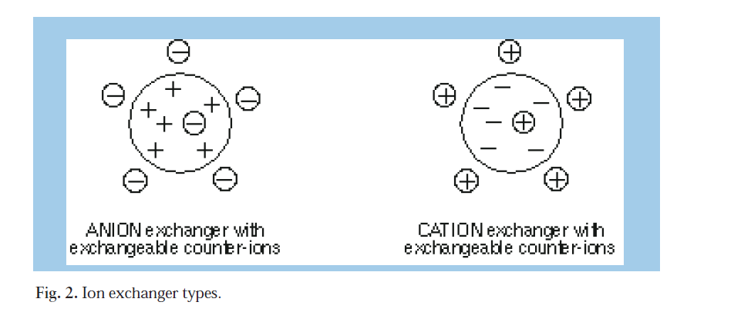

Slide 14
Some properties of strong ion exchangers are:
A very simple mechanism of interaction exists between the ion exchanger and the solute.
Ion exchange experiments are more controllable since the charge characteristics of the media do not change with changes in pH.

Slide 15
Capacity factor
The capacity or retention factor k is a measure of the retention of a component
and should not be confused with loading capacity (mg sample/ml) or ionic capacity
(mmol/ml).

Slide 16
Selectivity
The selectivity (a) defines the ability of the system to separate peaks i.e. the distance
between two peaks.
Good selectivity is a more important factor than high efficiency in determining
Resolution, since Rs is linearly related to selectivity but quadratically related
to efficiency. This means that a four fold increase in efficiency is required to double
the resolution under isocratic conditions.

Slide 18
Capacity
The total ionic capacity is the number of charged substituent groups per gram dry
ion exchanger or per ml swollen gel. Total capacity can be measured by titration
with a strong acid or base.

Slide 19
Product Guide
MonoBeads
Mono Q and Mono S are strong ion exchangers based on MonoBeads, monodisperse 10 μm hydrophilic polymer particles.
high performance
are best suite for analytical and small scale preparative applications.

Slide 20
MiniBeads
MiniBeads, a non-porous matrix of monodisperse, is the base for two strong ion exchangers, Mini Q and Mini S.
columns can also be used in FPLC and HPLC systems.

Slide 21
SOURCE
SOURCE 15Q, SOURCE 15S, SOURCE 30Q and SOURCE 30S are strong ion exchangers based on the same type of rigid polymer matrix as MonoBeads, polystyrene/ divinyl benzene beads.
are designed for high performance applications at both research and industrial scales.

Slide 22
SOURCE
high capacity
high flow rates
a minimum of back-pressure
thus allowing short cycle times, high productivity and scaleability.

Slide 23
Sepharose High Performance ion exchangers
Q and SP Sepharose High Performance are strong ion exchangers based on a 34
μm highly cross-linked agarose matrix
providing high physical and chemical stability.
These media are ideal for intermediate and final purification.
They should be used when resolution is the main objective.

Slide 24
Sepharose Fast Flow ion exchangers
Sepharose Fast Flow ion exchangers are based on 90 μm highly cross-linked 6%
agarose beads of high chemical and physical stability.
The exceptional flow characteristics make these ion exchangers the first choice for
separating crude mixtures early in a purification scheme.
with high demands on productivity

Slide 25
Sepharose Big Beads ion exchangers
Q and SP Sepharose Big Beads are strong ion exchangers designed for industrial
applications.
highly cross-linked 6% agarose beads.
Sepharose Big Beads is therefore the choice at the beginning of a purification scheme,
when large volumes are handled

Slide 26
STREAMLINE SP and STREAMLINE DEAE
are based on a modified Sepharose matrix, crosslinked 6% agarose.
The highly cross-linked nature
the binding capacity of STREAMLINE
adsorbents are dependent on each different molecule’s size and pI, the flow rate
etc.

Slide 27
Experimental design
Choice of ion exchanger
The choice of matrix and ionic substituent depends on:
1. The specific requirements of the application
2. The molecular size of the sample components
3. The isoelectric points of the sample components

Slide 28
Specific requirements of the application
Column separation, batch separation or expanded bed adsorption
If the separation is to be carried out using a batch separation technique rather
than column chromatography, the flow and packing characteristics of the matrix
are of minor importance.
The economy and high capacity of Sephadex based ion exchangers make them a natural choice.

Slide 29
The scale of the separation
The amount of sample to be processed is an important parameter when choosing
an ion exchange medium. For laboratory scale separations, any of the Amersham
Biosciences range of ion exchangers can be used.

Slide 30
The required resolution
When choosing an ion exchanger it is important to decide the degree of resolution
required from the separation.
Resolution in ion exchange chromatography depends upon the selectivity and efficiency
of the media. Maximum selectivity is often obtained by choosing one of the
gels carrying the strong exchanger groups Q or S/SP, since strong ion exchangers
can be used at any pH tolerated by the sample molecules.

Slide 31
The required resolution
Maximum efficiency is obtained by choosing a gel based on a small particle size
matrix. The media in order of their particle sizes and potential efficiencies are
MiniBeads (3 μm) > MonoBeads (10 μm) > SOURCE 15 (15 μm) > SOURCE 30
(30 μm)> Sepharose High Performance (34 μm) > Sepharose Fast Flow/ Sepharose
CL-6B/ Sephacel (90 μm) > Sephadex (40-125 μm in dry form) > STREAMLINE
adsorbents/Sepharose Big Beads (200 μm).

Slide 32
Economy
Column or batch procedures in which the ion exchanger is used once and thrown
away, as well as applications requiring large amounts of gel, may make economy a
major consideration. Sephadex A-50 and C-50 ion exchangers are the least expensive
in terms of bed volume,

Slide 33
The molecular size of the sample components
The accessibility of the sample components to the charged groups will determine
the available capacity of the ion exchanger for those particular substances.
All of the ion exchange media supplied by Amersham Biosciences, with the exception of
Sephadex based media, have exclusion limits for globular proteins in excess of 1 x 106.

Slide 34
Choice of exchanger group
Substances are bound to ion exchangers when they carry a net charge opposite to
that of the ion exchanger. This binding is electrostatic and reversible.
In the case of substances which carry only one type of charged group the choice of
ion exchanger is clear-cut. Substances which carry both positively and negatively
charged groups, however, are termed amphoteric and the net charge which they
carry depends on pH

Slide 35
Choice of exchanger group
Consequently at a certain pH value an amphoteric substance will have zero net charge. This value is termed the isoelectric point (pI) and at this point substances will bind to neither anion or cation exchangers.
The pH ranges in which the protein is bound to anion or cation exchangers and an
arbitrary range of stability are shown in Figure 37.

Slide 37
Choice of exchanger group
The pH of the buffer thus determines the charge on amphoteric molecules during
the experiment. In principle therefore, one could use either an anion or a cation
exchanger to bind amphoteric samples by selecting the appropriate pH.
In practice however, the choice is based on which exchanger type and pH give the best separation of the molecules of interest, within the constraints of their pH stability.

Slide 38
In summary:
1. If the sample components are most stable below their pI’s, a cation exchanger
should be used.
2. If they are most stable above their pI’s, an anion exchanger should be used.
3. If stability is high over a wide pH range on both sides of pI, either type of ion
exchanger can be used.

Slide 39
Determination of starting conditions
The isoelectric point
The starting buffer pH is chosen so that substances to be bound to the exchanger
are charged. The starting pH should be at least 1 pH unit above the isoelectric point for anion exchangers or at least 1 pH unit below the isoelectric point for cation exchangers to facilitate adequate binding.
Substances begin to dissociate from ion exchangers about 0.5 pH units from their isoelectric points at ionic strength 0.1 M (15).

Slide 40
Test-tube method for selecting starting pH
1. Set up a series of 10 test-tubes (15 ml).
2. Add 0.1 g Sephadex ion exchanger or 1.5 ml Sepharose or Sephacel ion exchanger to each tube.
3. Equilibrate the gel in each tube to a different pH by washing 10 times with 10 ml of 0.5 M buffer (see page 78 for choice of buffers for ion exchange). Use a range of pH 5-9 for anion and pH 4-8 for cation exchangers, with 0.5 pH unit
intervals between tubes.

Slide 41
Test-tube method for selecting starting pH
4. Equilibrate the gel in each tube at a lower ionic strength (0.05 M for Sephadex or 0.01 M for Sepharose and Sephacel ion exchangers) by washing 5 times with 10 ml of buffer of the same pH but lower ionic strength.
5. Add a known constant amount of sample to each tube.
6. Mix the contents of the tubes for 5-10 minutes.
7. Allow the gel to settle.
8. Assay the supernatant for the substance of interest. The results may appear as
shown in Figure 38 (a).

Slide 43
Electrophoretic titration curves (ETC)

Slide 44
Column selection based on electrophoretic titration curve analysis.
Maximum resolution can be expected at a pH where there is maximum separation
between the titration curves for individual solutes, using the ion exchanger type
indicated by the charge of the molecules at that particular pH. At this pH the difference
in electrophoretic mobilities and hence net charges between the species is
greatest. This principle is illustrated in Figure 41. The protein’s stability at the indicated
pH must be taken into consideration before applying these conditions to the
separation.

Slide 45
Column selection based on electrophoretic titration curve analysis.
If maximum separation is observed at a pH where the sample molecules are positively
charged, i.e. below their isoelectric points, maximum resolution will be obtained
using a cation exchanger such as Mono S, SOURCE S or SP Sepharose Fast
Flow.

Slide 46
Column selection based on electrophoretic titration curve analysis.
If the largest difference in electrophoretic mobility is found at a pH where the
components of interest are negatively charged, i.e. above their isoelectric points,
an anion exchanger such as Mono Q, SOURCE Q or Q Sepharose Fast Flow
should be chosen.

Slide 47
Column selection based on electrophoretic titration curve analysis.

Slide 48
Choice between strong and weak ion exchangers
Having selected a suitable starting pH to use on a cation or anion exchanger, it is necessary to choose between a strong and weak ion exchange group. In those cases where maximum resolution occurs at an extreme of pH and the molecules of interest are stable at that pH, the choice is clearly to use a strong exchanger.
The majority of proteins however, have isoelectric points which lie within the range 5.5 to 7.5 and can thus be separated on both strong and weak ion exchangers.

Slide 49
Choice of buffer
As with the choice of ion exchanger, there are a number of variables which have to
be considered. These include:
1. The choice of buffer pH and ionic strength.
2. The choice of buffering substance.
3. The price of the buffer if it is to be used in production process.

Slide 50
Choice of buffer pH and ionic strength
The highest ionic strength which permits binding of the selected substances and
the lowest ionic strength that causes their elution should normally be used as the
starting and final ionic strengths in subsequent column experiments (i.e. the starting
and limiting buffers for gradient elution). A third and higher ionic strength
buffer is frequently employed as a wash step before column regeneration and
re-use.

Slide 51
Choice of buffer substance
If the buffering ions carry a charge opposite to that of the functional groups of the
ion exchanger they will take part in the ion exchange process and cause local disturbances in pH. It is preferable, therefore, to use buffering ions with the same
charge sign as the substituent groups on the ion exchanger.

Slide 52
Test-tube method for selecting starting ionic strengths
1. Set up a series of tubes with ion exchanger as detailed on page 69.
2. Equilibrate the gel in each tube with 0.5 M buffer at the selected
starting pH (10 x 10 ml washes).
3. Equilibrate the gel in each tube to a different ionic strength, at constant pH, using a range from 0.05 M to 0.5 M NaCl for Sephadex ion exchangers and from 0.01 M to 0.3 M NaCl for Sephacel and
Sepharose ion exchangers. This will require 5 x 10 ml washes. Intervals of 0.05 M NaCl are sufficient.
4. Add sample, mix and assay the supernatant to determine the maximum ionic strength which permits binding of the substance of interest and the minimum ionic strength required for complete desorption.

Slide 53
Choice of column
Good results in column chromatography are not solely dependent on the correct
choice of gel media. The design of the column and good packing technique are also
important in realising the full separation potential of any gel.

Slide 54
Column design
The material used in the construction of the column should be chosen to prevent
destruction of labile biological substances and minimize non-specific binding to
exposed surfaces. The bed support should be designed so it is easily exchangeable
to restore column performance whenever contamination and/or blockage in the
column occurs.

Slide 55
Column dimensions
As for most adsorptive, high selectivity techniques, ion exchange chromatography
is normally carried out in short columns.
A typical ion exchange column is packed
to a bed height of 5-15 cm. Once the separation parameters have been determined,
scale-up is easily achieved by increasing the column diameter.

Slide 56
Quantity of ion exchanger
The amount of ion exchanger required for a given experiment depends on the
amount of sample to be chromatographed and on the available or dynamic capacity
of the ion exchanger for the sample substances. For the best resolution in ion
exchange chromatography, it is not usually advisable to use more than 10-20% of
this capacity, although this value can be exceeded if resolution is adequate.

Slide 57
Preparation of the ion exchanger
Having chosen the appropriate ion exchanger and starting buffer it is essential
that the exchanger is brought to equilibrium with start buffer before sample application.
Preparation of Sephadex ion exchangers, which are supplied as powders,
differs somewhat from the other ion exchangers available from Amersham
Biosciences, which are supplied pre-swollen and/or pre-packed.

Slide 58
Pre-swollen ion exchangers
SOURCE, Sepharose based, and DEAE Sephacel ion exchange media are supplied
ready to use. To prepare the gel, the supernatant is decanted and replaced with
starting buffer to a ratio of approximately 75% settled gel to 25% buffer.

Slide 59
Packing the column
As with any other chromatographic technique, packing is a very critical stage in an ion exchange experiment.
A poorly packed column gives rise to poor and uneven flow, zone broadening, and loss of resolution.

Slide 60
Checking the packing
The bed should be inspected for irregularities or air bubbles using transmitted
light from a lamp held behind the column. Be careful in the choice of any dye substances
used for checking beds as many of them are strongly charged. For example,
Blue Dextran 2000 binds strongly to anion exchangers.

Slide 61
Equilibrating the bed
Run at least two bed volumes of buffer through the ion exchange bed to allow the
system to reach equilibrium.
Counter-ion concentration, conductivity, and pH of the eluent should be checked against the ingoing solution. It is often sufficient just
to measure the pH of the effluent.

Slide 62
Sample preparation
Sample concentration
The amount of sample which can be applied to a column depends on the dynamic
capacity of the ion exchanger and the degree of resolution required. For the best
resolution it is not usually advisable to use more than 10-20% of this capacity.

Slide 63
Sample composition
The ionic composition should be the same as that of the starting buffer. If it is not,
it can be changed by gel filtration on Sephadex G-25
Sample volume
If the ion exchanger is to be developed with the starting buffer (isocratic elution), the sample volume is important and should be limited to between 1 and 5% of the
bed volume.
If however, the ion exchanger is to be developed with a gradient, starting conditions are normally chosen so that all important substances are adsorbed
at the top of the bed.

Slide 64
Sample viscosity
The viscosity may limit the quantity of sample that can be applied to a column. A high sample viscosity causes instability of the zone and an irregular flow pattern.
If the sample is too viscous, due to high solute concentration, it can be diluted with start buffer. High viscosity due to nucleic acid contaminants can be alleviated by precipitation with a poly-cationic macromolecule such as polyethyleneimine or protamine sulphate.

Slide 65
Sample preparation
In all forms of chromatography, good resolution and long column life time depend
on the sample being free from particulate matter. It is important that “dirty” samples
are cleaned by filtration or centrifugation before being applied to the column.
This requirement is particularly crucial when working with small particle matrices,
such as MiniBeads (3μm), MonoBeads (10 μm), SOURCE (15 and 30 μm) and
Sepharose High Performance (34μm).

Slide 66
Sample application
Sample application with an adaptor
This is the recommended method for all ion exchange media with the exception of
Sephadex based media and is always the method used with pre-packed columns or
when upward elution is employed. The sample may be applied to the column via
the adaptor in one of the following ways.

Slide 67
Sample application with an adaptor
Sample loops are a convenient way of
applying small samples in a reproducible
manner without interrupting the liquid
flow on the column. Sample loops can be
used in conjunction with LV-4 or SRV-4
valves (Fig. 45) or in conjunction with the
manual valves V-7 and IV-7 or the motorized
valves MV-7 and IMV-7 (Fig. 46).

Slide 68
Elution
If starting conditions are chosen such that only unwanted substances in the sample
are adsorbed, then no change in elution conditions is required since the substance
of interest passes straight through the column.
Normally, however, separation and elution are achieved by selectively decreasing
the affinity of the solute molecules for the charged groups on the gel by continuously
changing either buffer pH or ionic strength or possibly both. This procedure
is termed gradient elution.

Slide 69
Change of pH
As shown, the net charge on a molecule depends on pH.
Thus altering the pH towards the isoelectric point of a substance causes it to lose
its net charge, desorb, and elute from the ion exchanger. Figure 50 shows use of a
decreasing pH gradient in separation of haemocyanin fractions (25).

Slide 71
Change of pH
Since many proteins show minimum solubility in the vicinity of their isoelectric
points, care and precautions must be exercised to avoid isoelectric precipitation on
the column. The solubility of the sample components at the pH and salt concentrations
to be used during separation should always be tested in advance.

Slide 72
Change of ionic strength
At low ionic strengths, competition for
charged groups on the ion exchanger is
at a minimum and substances are bound
strongly. Increasing the ionic strength
increases competition and reduces the
interaction between the ion exchanger
and the sample substances, resulting in
their elution.

Slide 73
Gradient direction

Slide 74
Batch separation
There is essentially no difference in separation procedure between a column developed by stepwise elution and a batch procedure. Either the substance of interest
or contaminants may be attached to the ion exchanger.
Although batch procedures are less efficient than column techniques they may offer advantages in particular cases. When very large sample volumes with low
protein concentration have to be processed, the sample application time on a column can be very long and filtration of such a large sample can also be rather
difficult to perform. Binding the sample in batch mode will be much quicker and there will be no need to remove particulate matter.

Slide 75
Expanded bed adsorption
Expanded bed adsorption is a unit operation that uses STREAMLINE adsorbents and columns for recovering proteins directly from crude samples. Proteins are
recovered in a single pass without the need for prior clarification.
STREAMLINE has proven effective in purification proteins from fermentation or cell culture in extracellular processes, and has demonstrated its suitability when used with broth from cell lysis and homogenization in intracellular processes with soluble proteins.
STREAMLINE reduces the number of operations in a process by fusing the functions of clarification, concentration and capture (see page 109) in one operation.

Slide 76
Regeneration
After each cycle, bound substances must be washed out from the column to restore
the original function of the media. Ion exchange adsorbents can normally be
regenerated after each run by washing with a salt solution until an ionic strength
of about 2 M has been reached. This should remove any substances bound by
ionic forces. The salt should contain the counter-ion to the ion exchanger to facilitate
equilibration.

Slide 77
Cleaning
Cleaning-in-place (CIP) is the removal from the purification system of very tightly bound, precipitated or denatured substances generated in previous purification cycles. In some applications, substances such as lipids or denatured proteins may remain in the column bed instead of being eluted by the regeneration procedure.
If contaminants accumulate on the column over a number of purification cycles, they may affect the chromatographic properties of the column. If fouling is severe, it may also block the column, increasing the back-pressure and reducing the flow rate.

Slide 78
Sanitization
Sanitization is the inactivation of microbial populations. When a packed column
is washed with a sanitizing agent, the risk of contaminating the purified product
with viable micro-organisms is reduced. The most commonly used sanitization
method in chromatography today is to wash the column with NaOH. NaOH has
a very good sanitizing effect and also has the addition advantage of cleaning the
column.

Slide 79
Storage of unused media
Unused media should be stored in closed containers at +4 °C to +25 °C. Note that
it is important that the media are not allowed to freeze as the structure of the
beads may be disrupted by ice crystals. This disruption will generate fines.

Slide 80
Storage of used media
Used media should be stored at a temperature of +4 °C to +8 °C in the presence of an antimicrobial agent, e.g. 0.01 M NaOH or 20% ethanol according to the
recommendation given above.
Note that it is important that the media are not allowed to freeze as the structure of the beads may be disrupted by ice crystals.
This disruption will generate fines.

Slide 81
Binding conditions
Selectivity during adsorption to an ion exchanger is optimized by careful selection
of pH and ionic strength of the start buffer.
A pH far away from the isoelectric
point of the molecule of interest will give stronger binding and increased capacity
but may also have a negative impact on selectivity due to increased binding of contaminating molecules.

Slide 82
Applications
Ion exchange has proven to be one of the major methods of fractionation of labile
biological substances. From the introduction of the technique in the 1960s´ to the
development of modern high performance media, ion exchange chromatography
has played a major role in the separation and purification of biomolecules and
contributed significantly to our understanding of biological processes.

Slide 83
The design of a biochemical separation
Ion exchange chromatography, in common with other separation techniques in the life sciences, is rarely sufficient as the sole purification stage in the separation or analysis of complex biological samples.
Ion exchange is frequently combined with other techniques which separate according to other parameters such as size (gel filtration), hydrophobicity (hydrophobic interaction chromatography or RPC) or biological activity (affinity chromatography).

Slide 84
Application examples
Ion exchange chromatography has been used successfully to separate all classes of
charged biological molecules. The following are some representative examples.
Enzymes
Isoenzymes
Immunoglobulins
Nucleic acid separation
Polypeptides and polynucleotides

Slide 85
Fault finding chart

Slide 86
Fault finding chart

Slide 87
Fault finding chart

Slide 88
Fault finding chart

Slide 89
Fault finding chart

Slide 90
Fault finding chart

Slide 91
Fault finding chart

Slide 92
Fault finding chart

Slide 93
Fault finding chart

Slide 94
Fault finding chart

Slide 95
Fault finding chart

Slide 96
Fault finding chart

Slide 97
Fault finding chart

Slide 98
Fault finding chart

